Slide 1
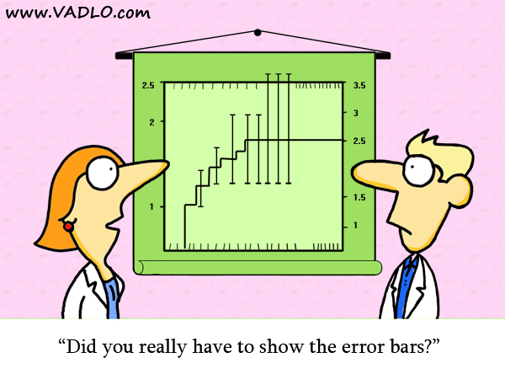
Experimental Measurements and their Uncertainties
Errors

Slide 2
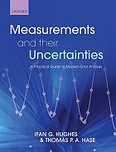
Error Course
Chapters 1 through 4
Errors in the physical sciences
Random errors in measurements
Uncertainties as probabilities
Error propagation

Slide 3
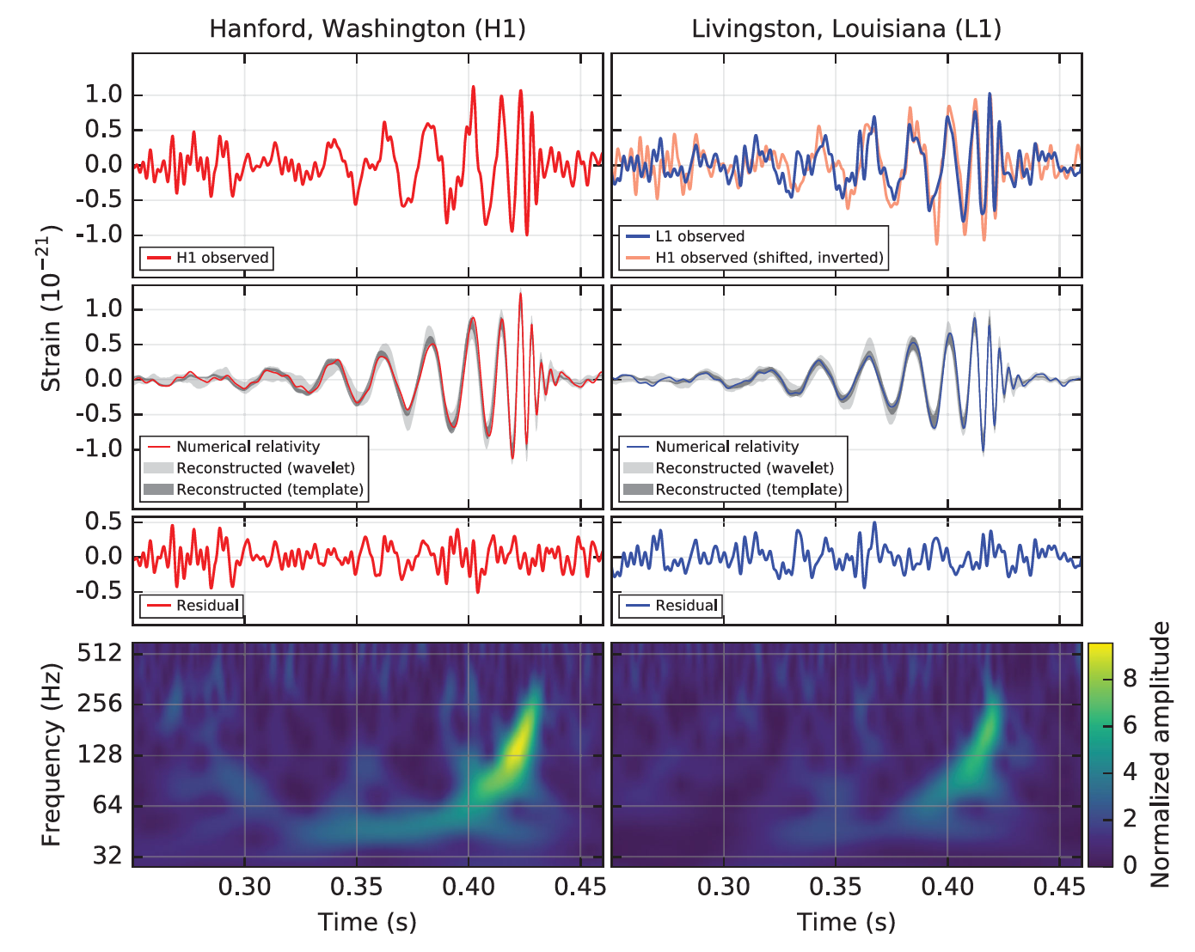
Errors in the physical sciences
Aim to convey and quantify the errors associated with the inevitable spread in a set of measurements and what they represent
• do the results agree with theory?
• are the results reproducible?
• has a new phenomenon or effect been observed?
Have we seen gravitational waves?
B. P. Abbott et al. Phys. Rev. Lett. 116, 061102 (2016)
Chapter 1 of Measurements and their Uncertainties

Slide 4
Errors in the physical sciences
There are two important aspects to error analysis
1. An experiment is not complete until an analysis of the numbers to be reported has been conducted
2. An understanding of the dominant error is useful when planning an experimental strategy
Chapter 1 of Measurements and their Uncertainties

Slide 5
The importance of error analysis
There are two types of error
A systematic error influences the accuracy of a result
A random error influences the precision of a result
A mistake is a bad measurement
‘Human error’ is not a defined term
Chapter 1 of Measurements and their Uncertainties

Slide 6
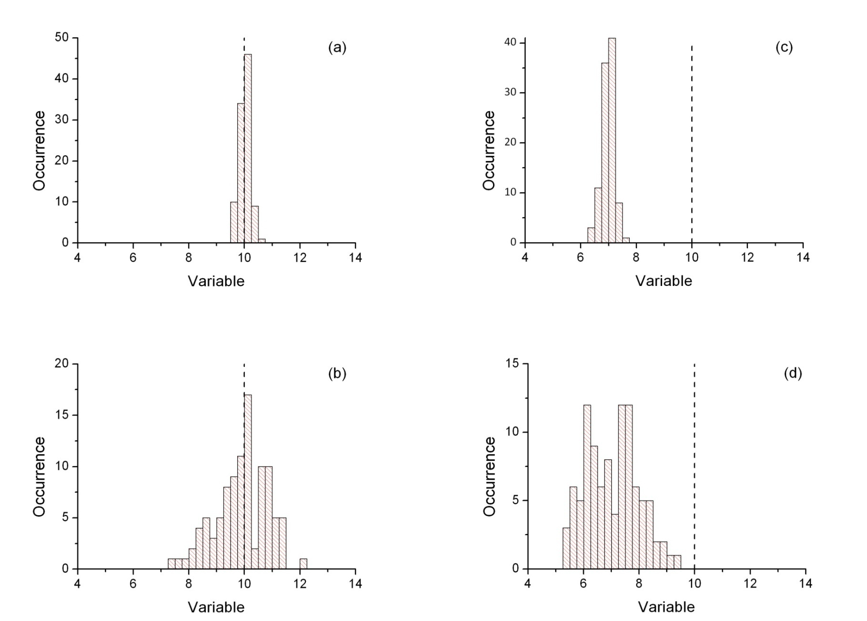


Accuracy and Precision
Precise and accurate
Precise and inaccurate
Imprecise but accurate
Imprecise and inaccurate
Chapter 1 of Measurements and their Uncertainties

Slide 7
Accurate vs. Precise
An accurate result is one where the experimentally determined value agrees with the accepted value.
In most experimental work, we do not know what the value will be – that is why we are doing the experiment - the best we can hope for is a precise result.

Slide 8
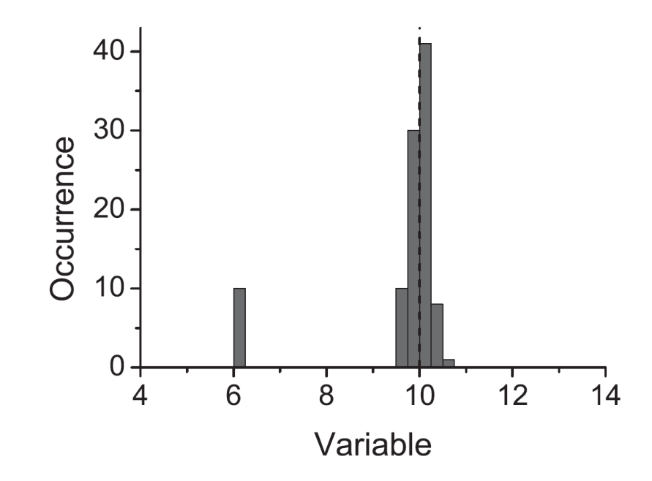
Mistakes
Take care in experiments to avoid these!
Misreading Scales
Multiplier (x10)
Apparatus malfunction
‘frozen’ apparatus
Recording Data
2.43 vs. 2.34
Page 5 of Measurements and their Uncertainties

Slide 9
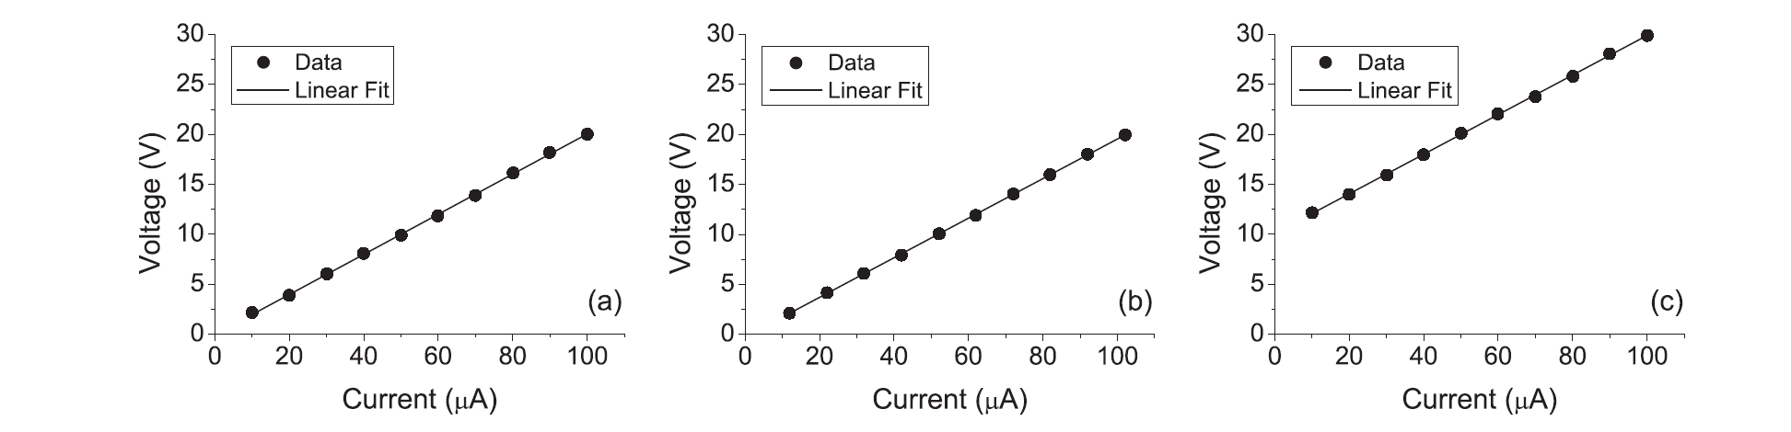
Systematic Errors
No systematic error
Systematic error on Current
Systematic error on Voltage
Best investigated Graphically:
Insertion errors
Calibration errors
Zero errors
Assumes you ‘know’ the answer – i.e. when you are performing a comparison with accepted values or models.
Pages 3 of Measurements and their Uncertainties

Slide 10
The Role of Error Analysis
What is the best estimate of x?
How do we calculate this error, α

Slide 11
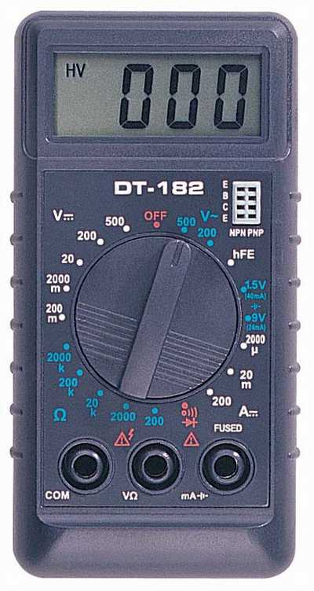
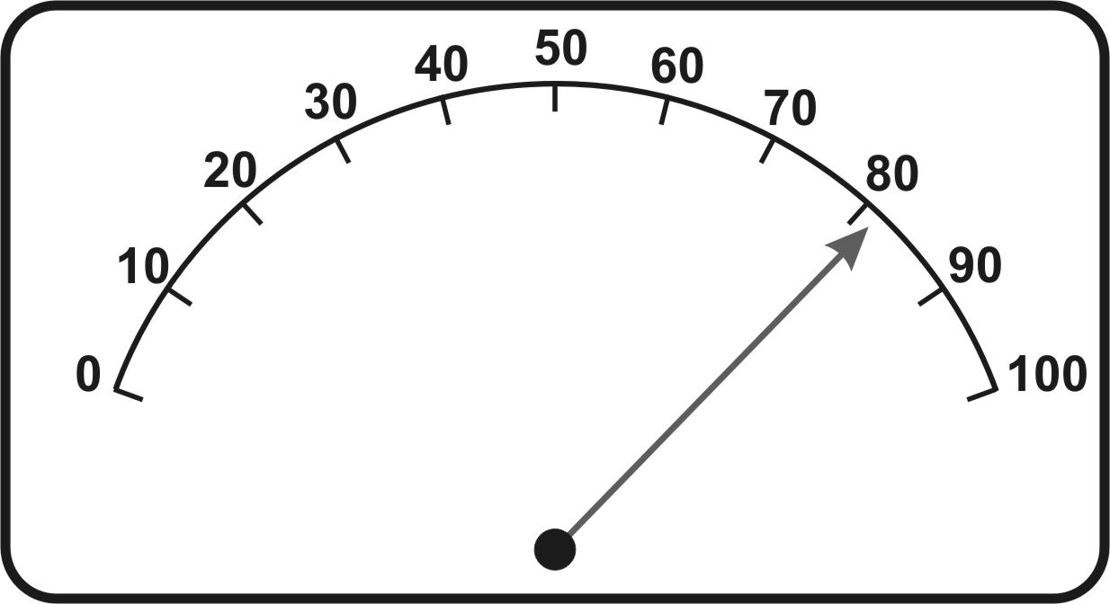
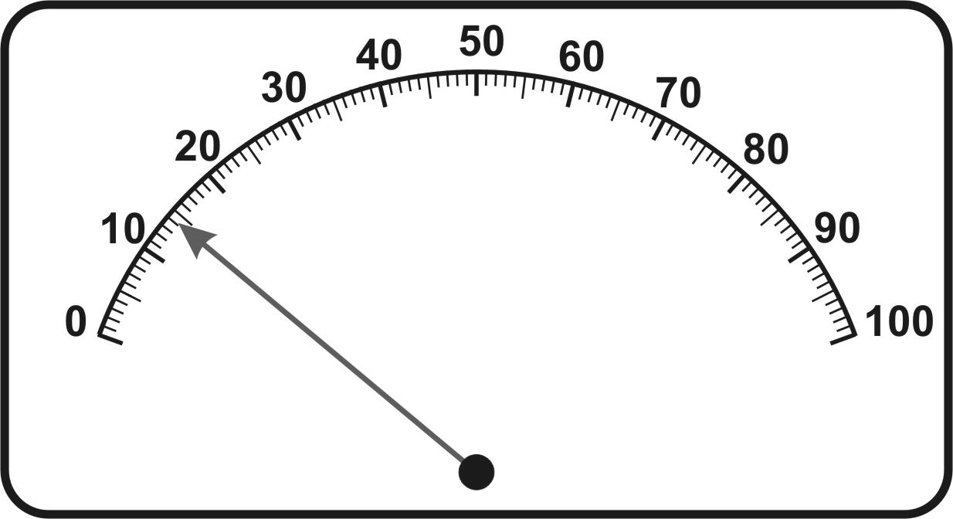
Precision of Apparatus
RULE OF THUMB: The most precise that you can measure a quantity is to the last decimal point of a digital meter and half a division on an analogue device such as a ruler.
BEWARE OF:
Parallax
Systematic Errors
Calibration Errors
Pages 5 & 6 of Measurements and their Uncertainties

Slide 12
Recording Measurements
The number of significant figures is important
Quoted Value | Implies | Error
15 |  | ±1
15.0 |  | ±0.1
15.00 |  | ±0.01
15.000 |  | ±0.001
When writing in your lab book, match the sig. figs. to the error

Slide 13
Error Course
Chapters 1 through 4
Errors in the physical sciences
Random errors in measurements
Uncertainties as probabilities
Error propagation

Slide 14
When to take repeated readings
If the instrumental device dominates
No point in repeating our measurements
If other sources of random error dominate
Take repeated measurements and use statistics to describe the distribution of data

Slide 15
Random Uncertainties
Random errors are easier to estimate than systematic ones.
To estimate random uncertainties we repeat our measurements several times.
A method of reducing the error on a measurement is to repeat it, and take an average. The mean, is a way of dividing any random error amongst all the readings.
Page 10 of Measurements and their Uncertainties

Slide 16
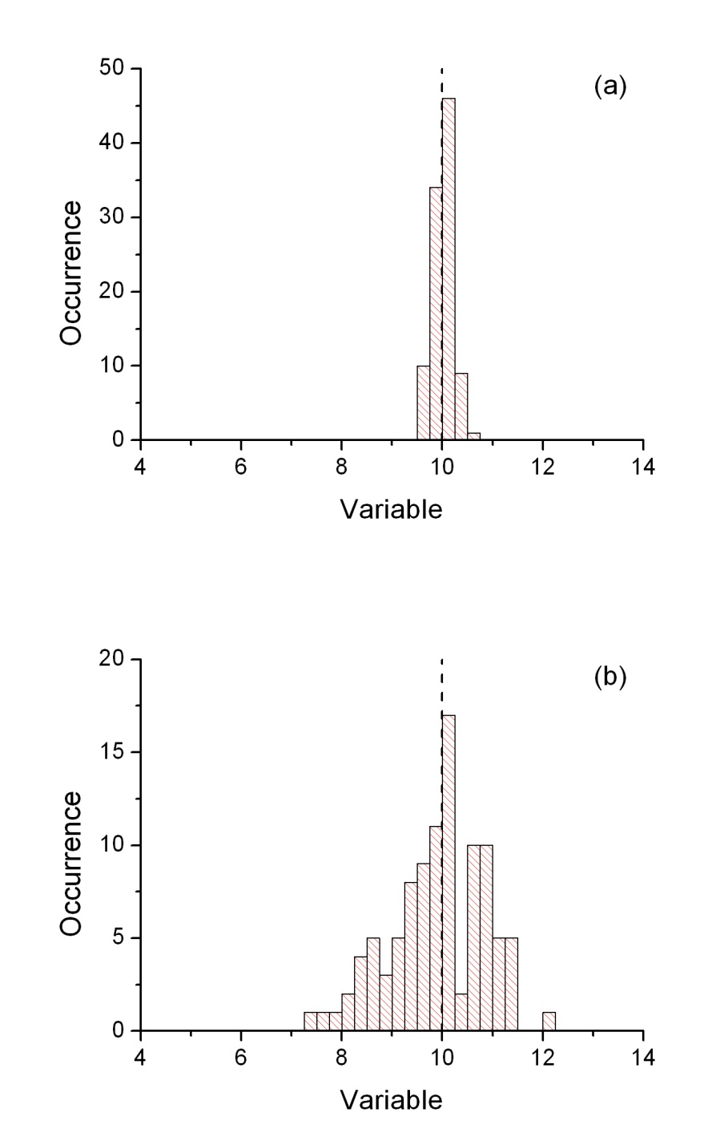
Quantifying the Width
The narrower the histogram, the more precise the measurement.
Need a quantitative measure of the width

Slide 17
Quantifying the data Spread
The deviation from the mean of the i^{th} data point, d_{i,} is the amount by which an observation, X_{i}, exceeds the mean:
We define the STANDARD DEVIATION as the root mean square of the deviations such that
Page 12 of Measurements and their Uncertainties

Slide 18
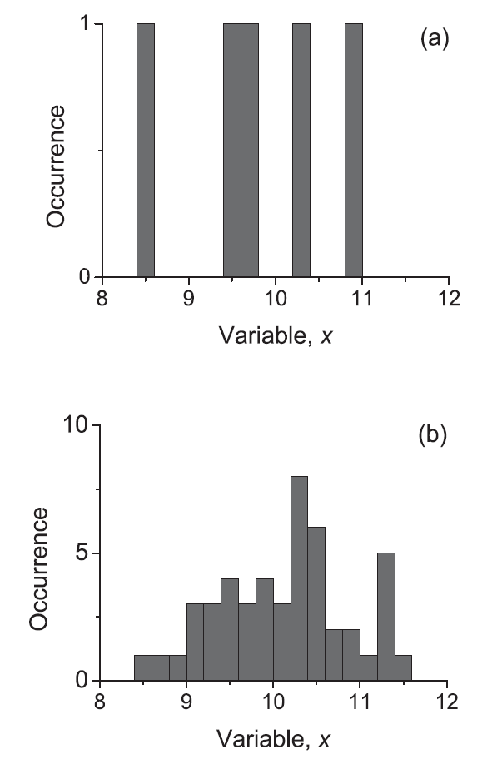
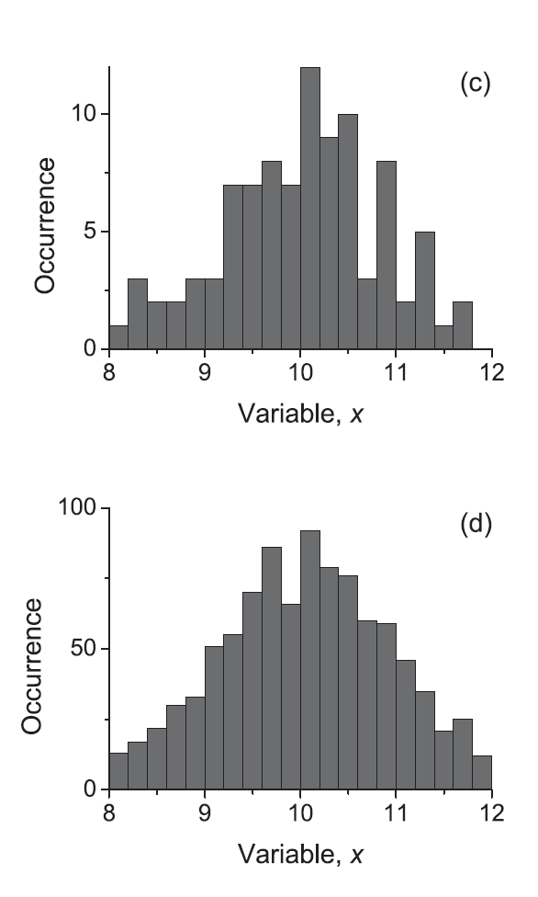
Repeat Measurements
As we take more measurements the histogram evolves towards a continuous function
5
100
50
1000
Chapter 2 of Measurements and their Uncertainties

Slide 19
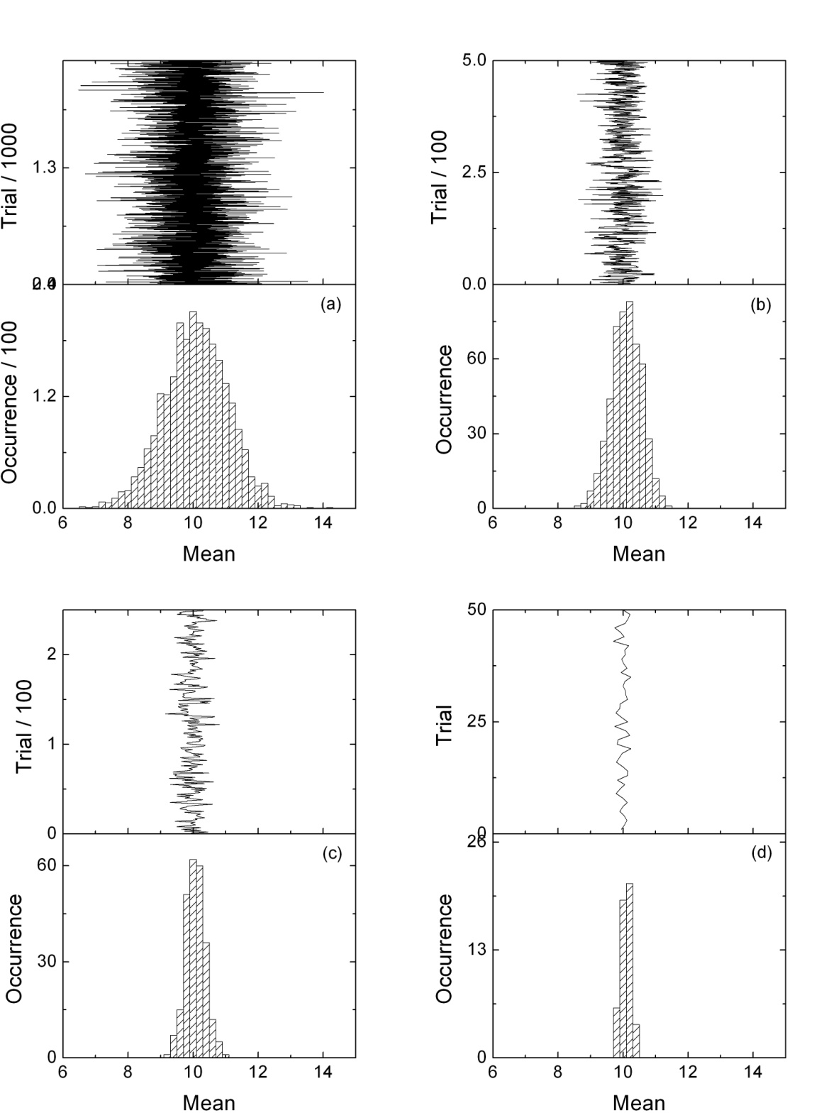
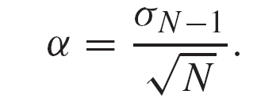
The Standard Error
Parent Distribution:
Mean=10, Stdev=1
α=1.0
α=0.5
b. Average of every 5 points
c. Average of every 10 points
d. Average of every 50 points
Standard deviation of the means:
α=0.3
α=0.14
Chapter 2 of Measurements and their Uncertainties

Slide 20
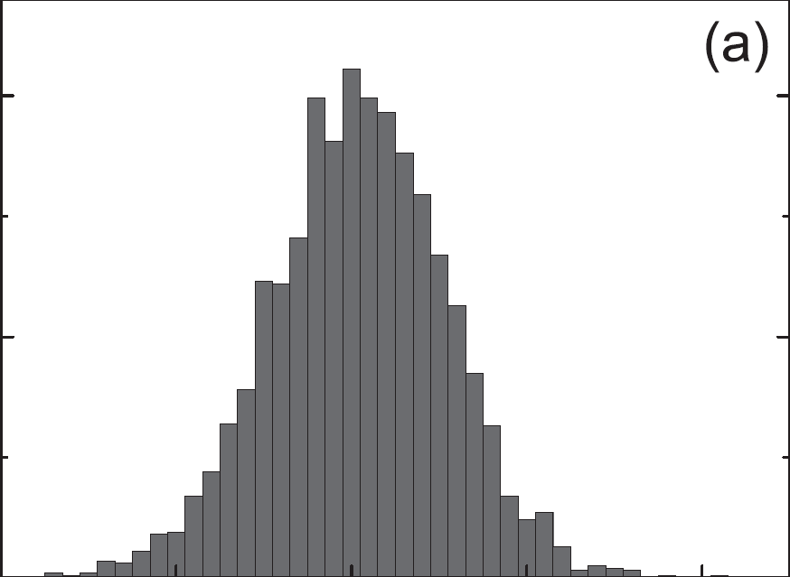
The standard error
The mean tells us where the measurements are centred
The standard error is the uncertainty in the location of the centre (improves with higher N)
The standard deviation gives us the width of the distribution (independent of N)
Page 14 of Measurements and their Uncertainties

Slide 21
What do we Write Down?
The precision of the experiment is therefore not controlled by the precision of the experiment (standard deviation), but is also a function of the number of readings that are taken (standard error on the mean).
Page 16 of Measurements and their Uncertainties

Slide 22
Checklist for Quoting Results:
Best estimate of parameter is the mean, x
Error is the standard error on the mean, α
Round up error to the correct number of significant figures [NEARLY ALWAYS 1]
Match the number of decimal places in the mean to the error
Include units
You will only get full marks if ALL five are correct
Page 16 of Measurements and their Uncertainties

Slide 23
Error Course
Chapters 1 through 4
Errors in the physical sciences
Random errors in measurements
Uncertainties as probabilities
Error propagation

Slide 24
Confidence Limits
Range centered on Mean
Measurements within Range | 68% | 95% | 99.7%
Measurements outside Range | 32% 1 in 3 | 5% 1 in 20 | 0.3% 1 in 400
The error is a statement of probability. The standard deviation is used to define a confidence level on the data.

Slide 25
Comparing Results
RULE OF THUMB:
If the result is within:
1 standard deviation it is in
EXCELLENT AGREEMENT
2 standard deviations it is in
REASONABLE AGREEEMENT
3 or more standard deviations it is in DISAGREEMENT
Page 28 of Measurements and their Uncertainties

Slide 26
Counting – it’s not normal
The errors on discrete events such as counting are not described by the normal distribution, but instead by the Poisson Probability Distribution
Valid when:
Counts are Rare events
All events are independent
Average rate does not change over the period of interest
Radioactive Decay,
Photon Counting – X-ray diffraction

Slide 27
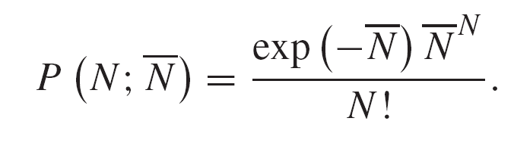

Poisson PDF
N | α_{N} | % error
1 | 1 | 100
10 | 3 | 30
100 | 10 | 10
1000 | 32 | 3
10,000 | 100 | 1
100,000 | 316 | 0.3
“A high count rate increases the precision of the experiment”
Pages 28-30 of Measurements and their Uncertainties

Slide 28
Error Course
Chapters 1 through 4
Errors in the physical sciences
Random errors in measurements
Uncertainties as probabilities
Error propagation

Slide 29
Simple Functions
We often want measure a parameter and its error in one form, but we then wish to propagate through a secondary function:
Chapter 4 of Measurements and their Uncertainties

Slide 30
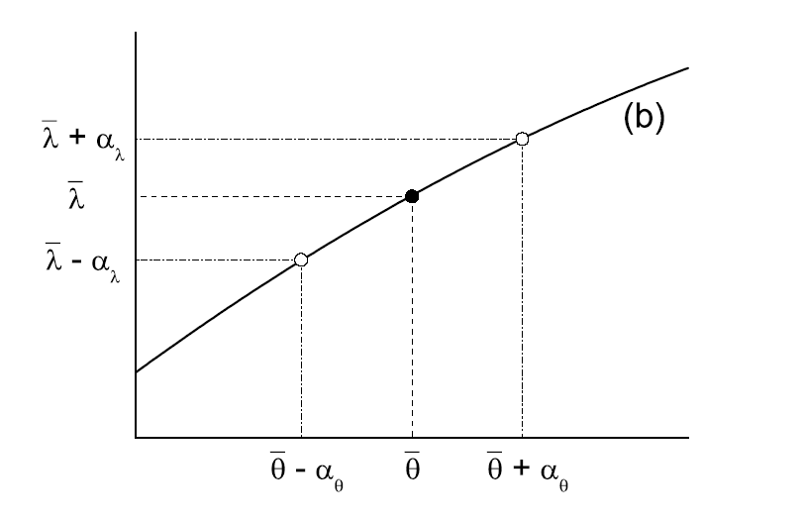
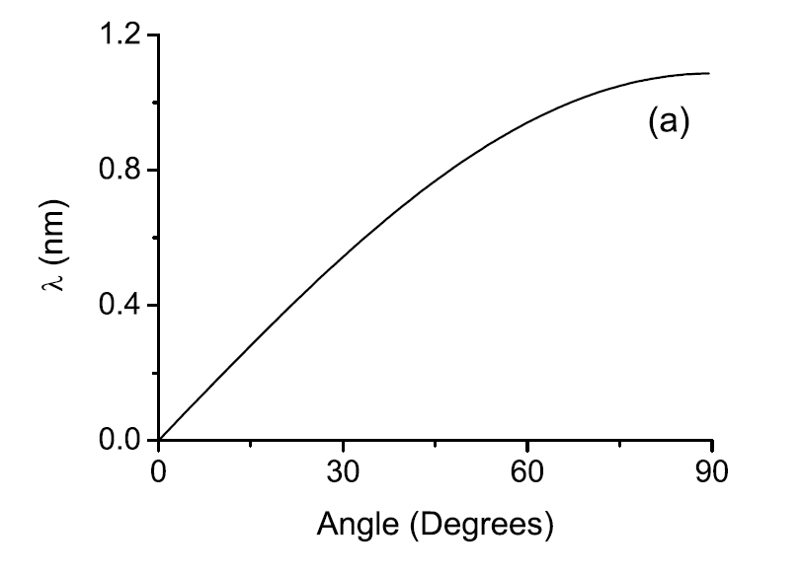

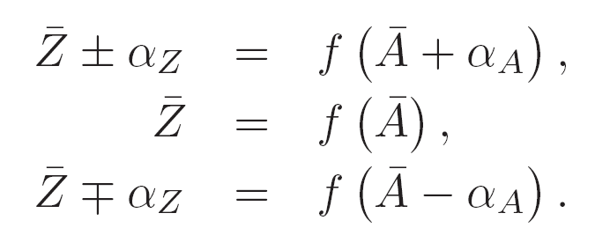

Functional Approach
Z=f(A)
Chapter 4 of Measurements and their Uncertainties

Slide 31
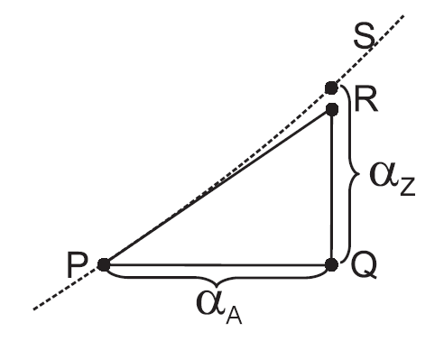
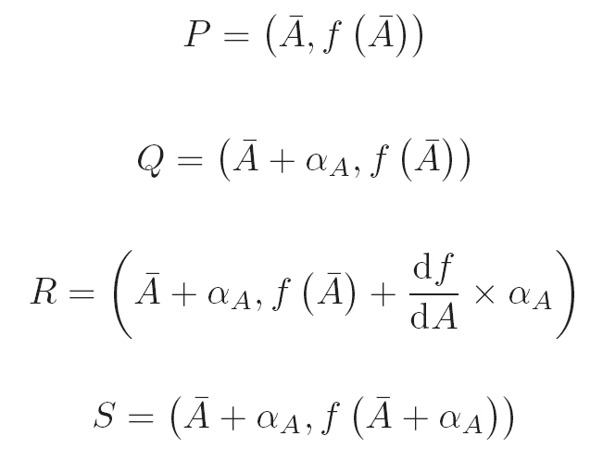
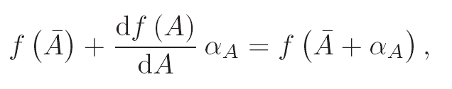
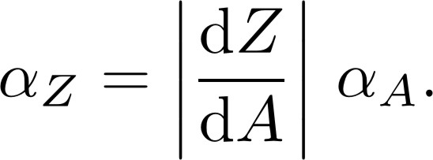
Calculus Approximation
Z=f(A)
Chapter 4 of Measurements and their Uncertainties

Slide 32
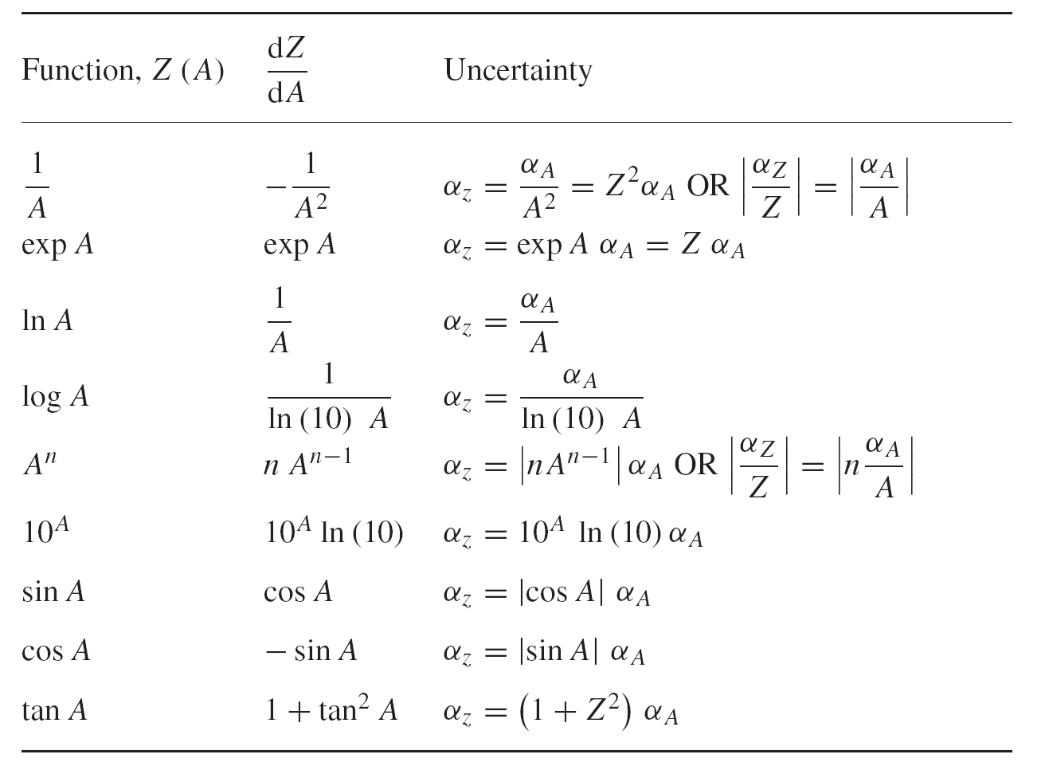
Single Variable Functions
Functional or Tables (differential approx.)
Chapter 4 & inside cover of Measurements and their Uncertainties

Slide 33
Cumulative Errors
How do the errors we measure from readings/gradients get combined to give us the overall error on our measurements?
What about the functional form of Z?
HOW??

Slide 34
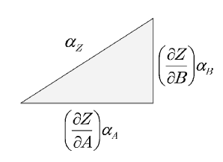
Multi-Parameters
Need to think in N dimensions!
Errors are independent – the variation in Z due to parameter A does not depend on parameter B etc.

Slide 35




Z=f(A,B,....)
Error due to A:
Error due to B:
Pythagoras

Slide 36
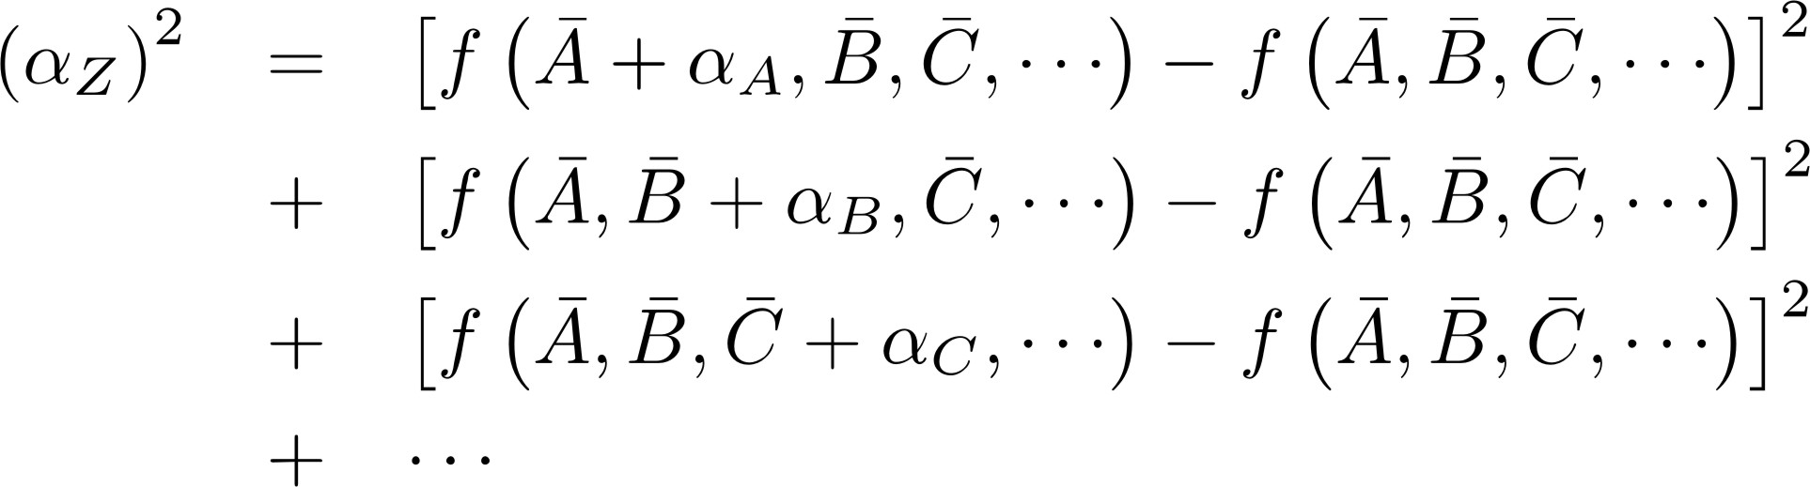
2 Methods

Slide 37
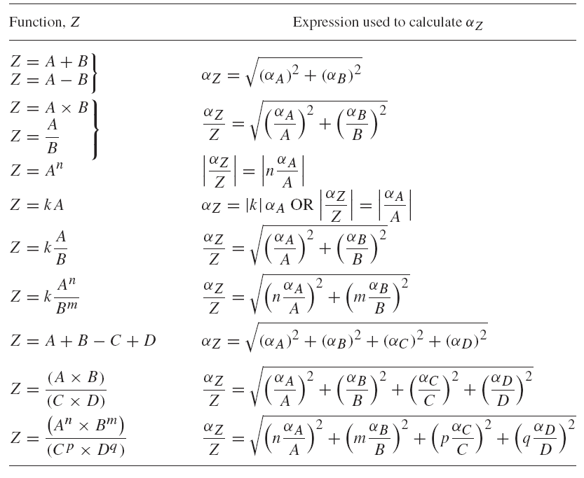
Multi Variable Functions
Functional or Tables (differential approx.)
Chapter 4 & back cover of Measurements and their Uncertainties

Slide 38
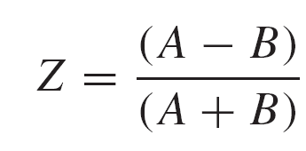
Take Care!
Parameters must be independent:

Slide 39
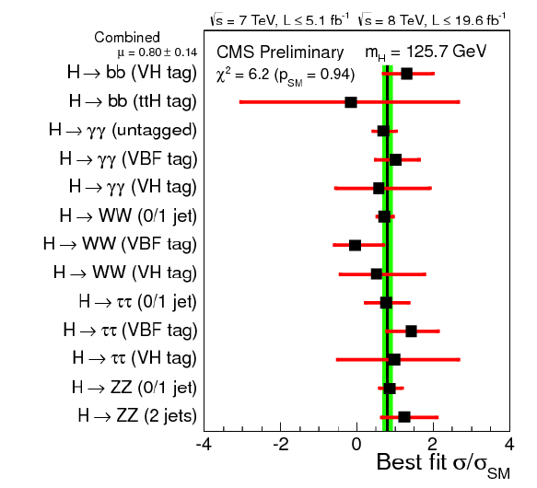
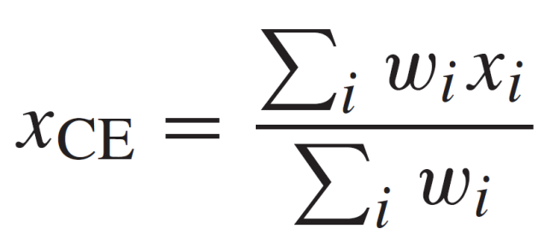
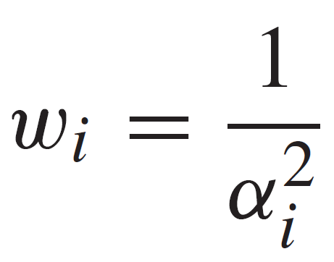
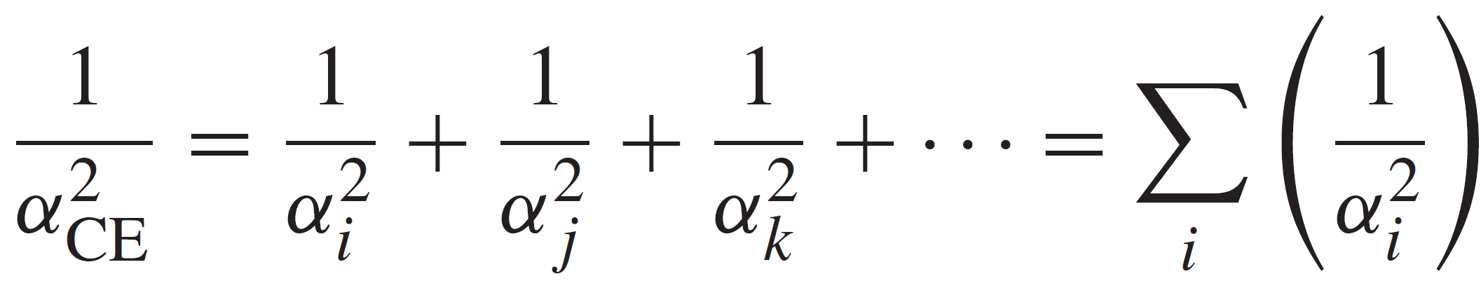
The Weighted Mean
There can be only one!
where
The error on the weighted mean is:
Pages 50 of Measurements and their Uncertainties

